Slide 1
Capstone Project: Analysis of AIRBNB Dataset
Report Submitted by: Ayush Kumar
Hero Vired Batch ABADS 7

Slide 2
Introduction
The project involves analyzing data from an online aggregator for short-term rental properties in Antwerp, Belgium. The goal is to develop a machine learning-based solution to suggest appropriate listing prices to property owners when they list their properties for rent.
The dataset contains information from various tables, which includes :-
Calendar Table: Contains data on listings in chronological order, including listing ID, date, availability status, price, minimum and maximum nights, etc.
Listings Table: Provides details of each listing, such as listing ID, URL, name, description, location coordinates (latitude and longitude), property type, room type, number of guests accommodated, number of bathrooms, bedrooms, beds, amenities, and host ID.
Hosts Table: Includes information about hosts who have posted listings, including host ID, name, registration timestamp, location, and self-reported about section.
Reviews Table: Contains data on reviews for listings, including review ID, listing ID, date of review, reviewer ID, reviewer name, and review comments.

Slide 3
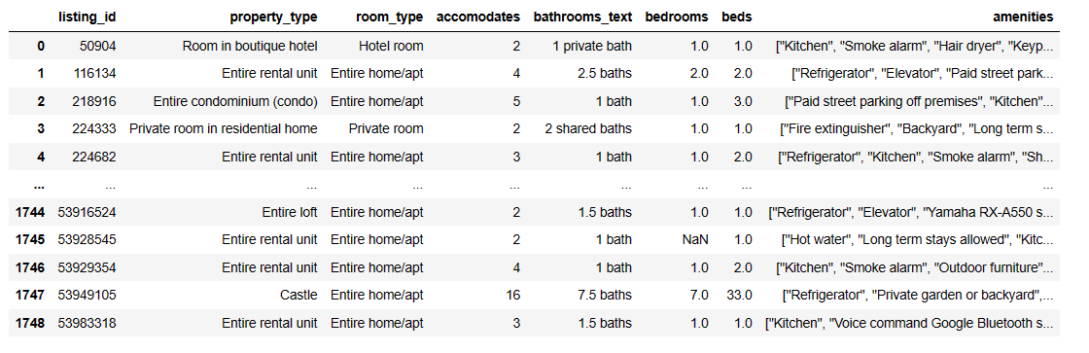
Data understanding and feature creation
Key findings:-
Number of rows and unique listing IDs in the Calendar table
Transformations required for the price column
Potential transformations identified in Listings, Hosts, and Reviews tables.

Slide 4
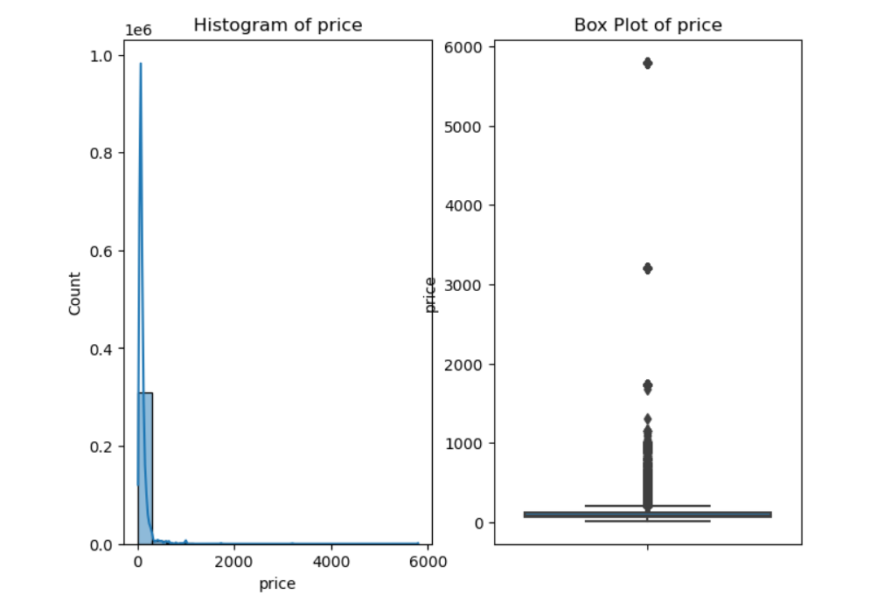
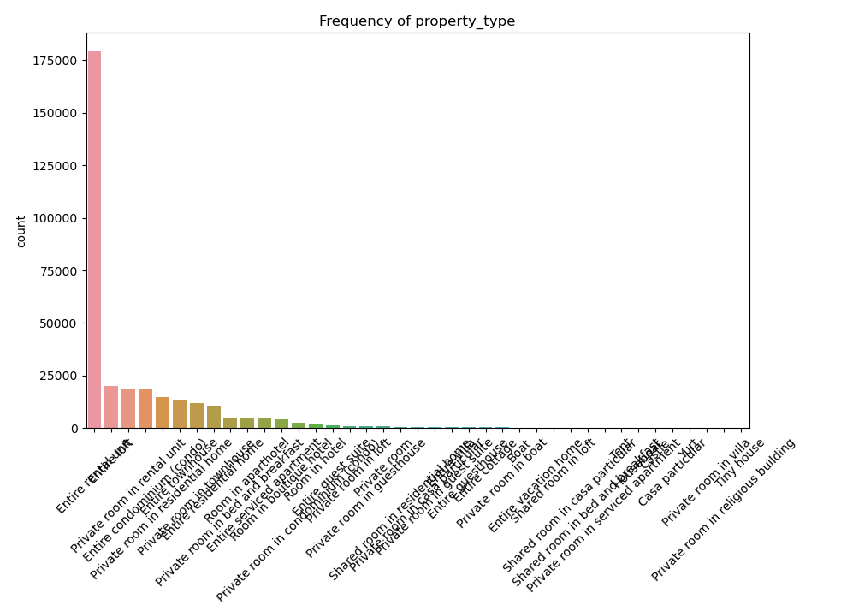
Data quality and checks
Key findings:
Continuous variables analysis
Categorical variables analysis
Data anomalies identified and addressed

Slide 5
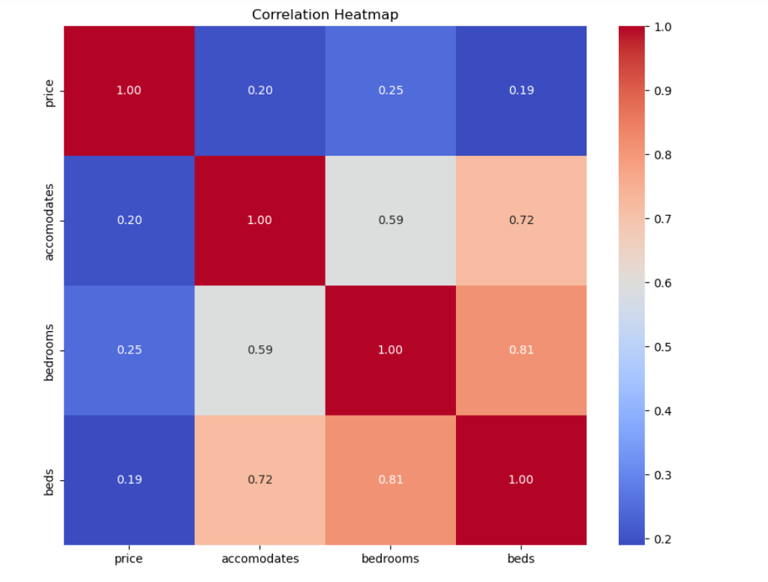
Checking correlation between variables
Key findings:-
Correlation heatmap between target and predictor variables
We observed positive correlations between the listing price and variables such as accomodates, bedrooms, and bathrooms, indicating that as these variables increase, the listing price tends to increase as well.
Also, there may be correlations between certain predictor variables, which could impact multicollinearity in our regression models.

Slide 6
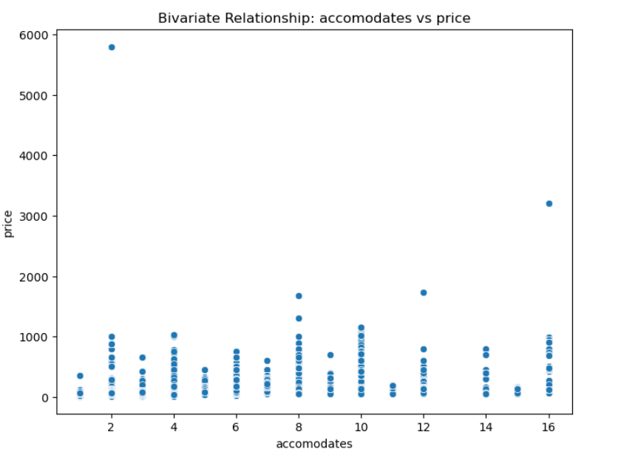
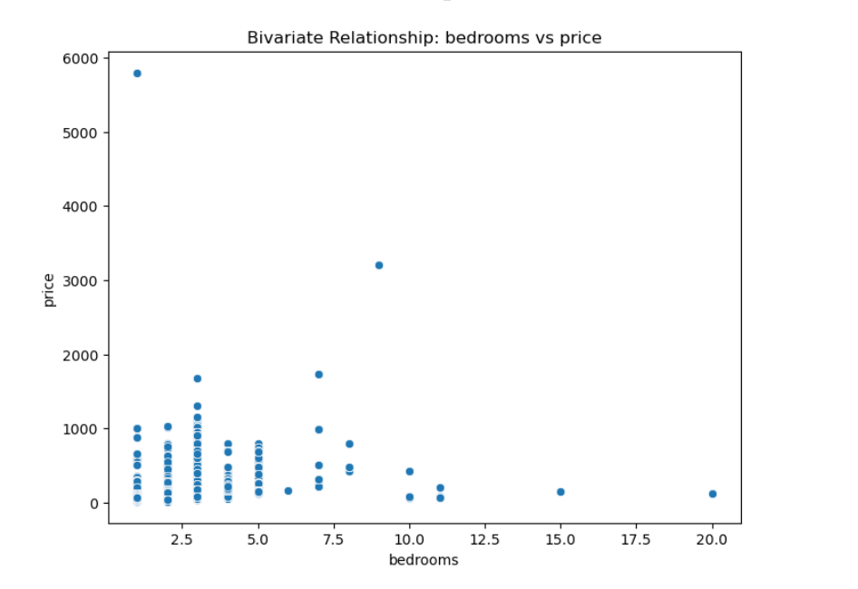
Checking Bivariate relationships between variables
Key findings:-
Bivariate relationships (scatter plots) between each predictor and the target variable.
Scatter plots allowed us to identify any linear or non-linear relationships between the predictor variables and the listing price.
Similarly, scatter plots helped us identify outliers or unusual patterns in the data, which could impact the accuracy of our regression models.

Slide 7
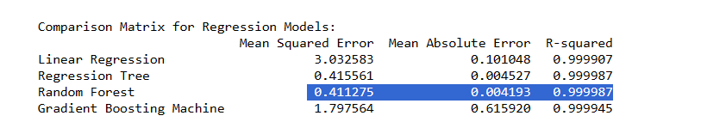
Modeling and insights
Key findings:-
Train/test/validation splits
Regression models used (Linear Regression, Regression Trees, Random Forest, GBM)
Comparison matrix of different regression models
Metrics used for comparison (MSE, MAE, R-Squared)
The model with the lowest error metrics and the highest R-squared value is generally preferred.

Slide 8
Over View
The project revolves around building a machine learning solution to suggest appropriate listing prices for properties in Antwerp, Belgium, which are available for short-term rental through online reviews.
Top 5 Most Important Predictors and Their Impact:-
Accommodates: This predictor has the highest feature importance score, indicating that the number of guests the property can accommodate has a significant impact on its price.
Bedrooms: The number of bedrooms is another important predictor, suggesting that properties with more bedrooms tend to have higher prices.
Room Type: The type of room could influence the perceived value and thus affect the price.
Property Type: Certain property types might be more desirable or offer unique features that justify higher prices.
Bathrooms: The number of bathrooms also plays a role in determining the price of a property.

Slide 9

Thank you

